Slide 1

Computer Systems Fundamentals
H175 34
Lecture 3
Arithmetic Operations in Binary and Hex

Slide 2
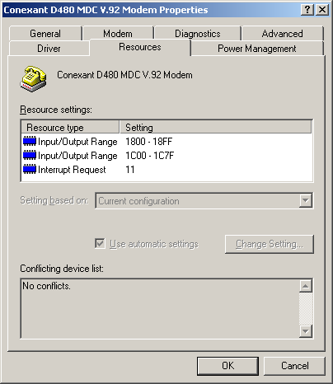
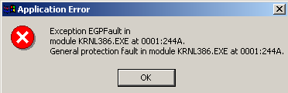
Performing Arithmetic
Last week, we looked at the Hexadecimal counting system, and we saw how computers displayed information using a base of 16.

Slide 3

Arithmetic in Base 10
Some tasks you will be required to complete are additions and subtractions in bases of both 2 and 16.
First, let’s recap on how to do it in base 10.

Slide 4
Adding in Denary
Adding the number 1375 to 4614 is relatively easy. We just add the numbers in each column, and put the answers at the bottom.
Thousands | Hundreds | Tens | Units
1 | 3 | 7 | 5
4 | 6 | 1 | 4
5 | 9 | 8 | 9
In each column, the total comes to less than 10, so we don’t have to worry about “carrying over”.

Slide 5

Adding in Denary
Adding, say, 2795 to 1489 is going to be harder……
Thousands | Hundreds | Tens | Units
2 | 7 | 9 | 5
1 | 4 | 8 | 9
1
1
1
12
18
14
4
2
8
4
5 and 9 make 14, but we are only allowed to go up to 9. We have made a group of 10, with 4 left over, so we carry the 10 across to the next column. We continue with the rest of the columns…..

Slide 6
Adding in Hexadecimal
Adding in hexadecimal is exactly the same as in decimal, but remember you can go up to 15 in each column…
4096s | 256s | 16s | 1s
2 | 6 | 7 | 1
C | 6 | 3 | A
2 + 12 = 14 (E)
E
6 + 6 = 12 (C)
C
7 + 3 = 10 (A)
A
1 + 10 = 11 (B)
B
In each column, the total comes to less than 16, so we don’t have to worry about “carrying over”.

Slide 7
Adding in Hexadecimal
But in this example, we will have to carry each time we make a group of 16…
4096s | 256s | 16s | 1s
2 | E | 9 | 9
B | B | C | 9
1
1
1
26 (16 and 10)
22 (16 and 6)
18 (16 and 2)
E
A
6
2
9 and 9 make 18, but we are only allowed to go up to 15. We have made a group of 16, with 2 left over, so we carry the 16 group across to the next column. We continue with the rest of the columns…..

Slide 8

Adding in 16s…
One for you to try….
256s | 16s | 1s
2 | 7 | C
A | 9 | 7
1
1
13
D
17 (16 and 1)
1
19 (16 and 3)
3

Slide 9
Subtraction in Denary
You will also have to subtract numbers in different bases. Let’s do a simple subtraction in denary, to start us off….
Thousands | Hundreds | Tens | Units
4 | 9 | 7 | 5
1 | 3 | 2 | 4
3 | 6 | 5 | 1
In each column, the first number is bigger than the second one, so we don’t need to worry about “borrowing” from the column on the left.

Slide 10
Denary Subtraction with Borrow
Subtracting 1489 from 2375 requires borrowing from each column on the left……
Thousands | Hundreds | Tens | Units
2 | 3 | 7 | 5
1 | 4 | 8 | 9
-1 = 1
- 1 = 2
+10 = 12
- 1 = 6
+ 10 = 16
+10 = 15
0
8
8
6
We can’t take 9 from 5, so we “borrow” from the “tens” column, and turn the 5 into 15…….

Slide 11
Hex Subtraction with Borrow
Subtracting 1C2F from 237A requires borrowing from each column on the left……
4096s | 256s | 16s | 1s
2 | 3 | 7 | A
1 | C | 2 | F
-1 = 1
+16 = 19
- 1 = 6
+16 = 26
19 – 12 = 7
26 – 15 = 11 (B)
0
7
4
B
We can’t take 15 from 10, so we “borrow” from the “16s” column, and turn the 10 into 26…….

Slide 12

Try This…
4096s | 256s | 16s | 1s
A | 2 | 1 | 3
5 | B | 7 | C
-1 = 9
-1 = 1
+16 = 17
- 1 = 0
+ 16 = 16
+16 = 19
9 – 5 = 4
17 – 11 = 6
16 – 7 = 9
19 – 12 = 7
4
6
9
7

Slide 13


We saw in week 1 that Computers can only “understand” one language - binary.
Everything a computer stores or manipulates is reduced to a series of switches, which are either
ON - - 1 or OFF - - 0
Values are actually stored as combinations of on/off, high voltage/ground, magnetized/not magnetized, and so on, using the digits 1 and 0 to represent these values.

Slide 14

Program execution and the manipulation of data depend on the combinations of 1s and 0s changing.
This happens billions of times per second - typically 1 x 10⁹ times per second per GHz of processor.

Slide 15

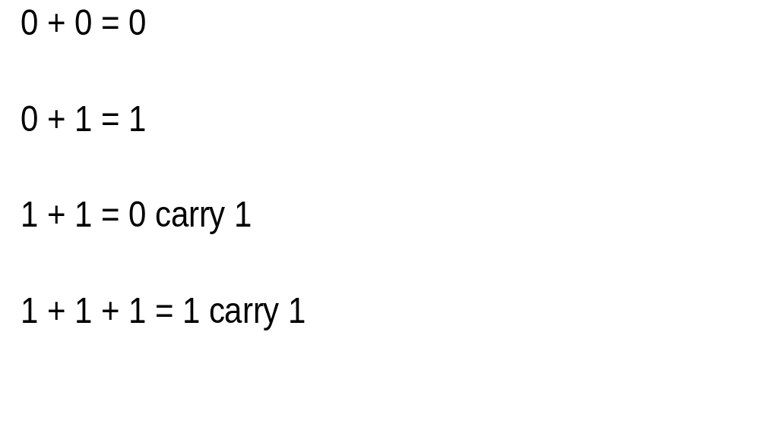
Write this wee table of numbers down before you start…..

Slide 16
Adding the following numbers is easy...
1
0
1
1
1
0
0
1
1
0
0
0
0
0
0
0
1
0
0
1
All we have to do is add 1’s and zeroes!
1
0
1
1
1
0
1
1
1
1

Slide 17
This one is harder...
carry 1
carry 1
carry 1
carry 1
carry 1
carry 1
0
0
1
1
1
1
0
0
1
0
0
1
0
0
1
1
1
0
1
1
1 + 1 = 0 carry 1
1 + 1 = 0 carry 1
1 + 1 = 0 carry 1
1 + 1 = 0 carry 1
1 + 1 = 0 carry 1
1+1+1 = 1 carry 1
1
0
0
0
1
0
1
1
0
1

Slide 18
Try…
0
1
1
0
1
1
0
1
1
0
added to ...
1
1
0
1
1
0
0
0
1
0
The answer is...
0
1
0
0
0
1
1
0
0
0

Slide 19
You may have noticed that the last addition between the two 10-digit numbers gave us an 11-digit answer!
The whole answer was 101 0001 1000.
If only 10 digits had been set aside to hold the answer, this calculation would have resulted in an “overflow” - trying to fit too large a number into too small a space!

Slide 20

Subtracting the second number from the first in binary can be pretty awkward sometimes...
0
1
1
0
1
1
0
1
1
1
0
0
1
0
0
1
0
0
0
1
This sum is not too bad as we are just subtracting zeroes, or 1’s, from 1’s.
0
1
0
0
1
0
0
1
1
0

Slide 21
But what about ...
0
2
0
2
0
2
1
0
1
1
0
1
0
1
0
1
minus
0
1
1
0
1
1
0
0
1
1
0 - 1 can’t do! So we “borrow” 1 from the right hand column., which then becomes 0... And now we can take 1 from 2, leaving 1
Same thing...
Same thing...
0
1
0
0
1
0
0
0
1
0

Slide 22

A wee one for you to try....
0
1
0
0
1
0
0
0
1
0
minus
0
0
1
0
1
0
0
0
0
1
You should have
0
0
1
0
0
0
0
0
0
1
Don’t worry if you didn’t get it all... We will be looking at another method next.

Slide 23
Two’s Complement
Two’s complement allows us to use addition to subtract two binary numbers, we do this by:
Inverts the number that is to be subtracted.
e.g. 00110011 would be inverted to 11001100
then add 1
Finally add this to the first binary number

Slide 24
We saw previously that
0
1
0
0
1
0
0
0
1
0
minus
0
0
1
0
1
0
0
0
0
1
Equals
0
0
1
0
0
0
0
0
0
1
Using two’s Complement
0
1
0
0
1
0
0
0
1
0
Invert
Add 1
Finally add to above
1
0
1
1
0
1
0
1
0
1
0
1
0
1
0
1
0
1
1
0
1
1
0
1
1
0
1
1
1
0
Equals
0
0
1
0
0
0
0
0
0
1

Slide 25

Any Questions?

Slide 26

Summary
When working in hex, we use the digits 0 – F.
When working in binary, we use only the digits 0 and 1
When a hex addition becomes 16 or more, one has to be carried to the column on the left.
When a binary addition becomes 2 or more, one has to be carried to the column on the left.
When a hex subtraction cannot be done, sixteen has to be borrowed from the column on the left.
When a binary subtraction cannot be done, two has to be borrowed from the column on the left.
Two’s complement can be used as an alternative to subtracting binary

Slide 27


Credits
Hex examples © Chrissie Nyssen
All other graphics © Focus Multimedia with open licence, unless stated
All other contents © Aberdeen College 2010

